Slide 1
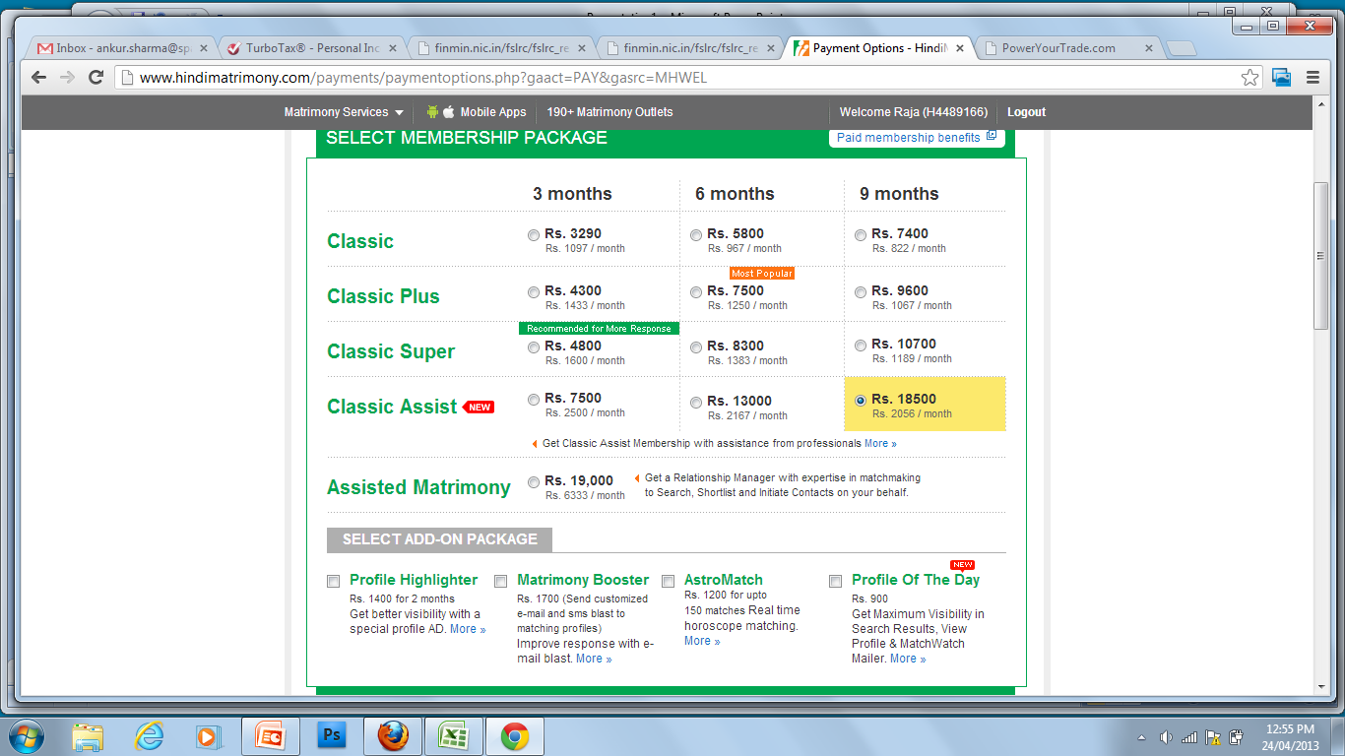
2013 Tax Filing Products for Corporate & Alliance
Who we are?
India’s most trusted online tax preparation and filing company
Largest E-Return Intermediary (ERI) authorized by Income Tax Department
Only tax portal having security certified by CERT-IN empanelled consultants
KEY TAX CHANGES RELEVANT TO EMPLOYEES
E-filing Mandatory
Every individual who is required to file the tax returns must do so only via the electronic filing of returns
E-return intermediaries authorized by the income tax department to facilitate e-filing
Income Tax Scrutiny Notices
Data mismatch notices to salaried employees
Defective ITR notices to employees & self-employed
Non-filing of ITR notices to several lakh employees
Our Strengths
Always there for your support
We understand return filing is not ‘file-it-forget-it’ service. Our processes ensure that we are there for you every step of the way – preparation, filing, assessment, scrutiny, liaison, rectification or refund.
No mis-selling
We do not sell any financial products in the guise of filing ITR. We do not share the data of our customers with any third party. It helps us stay not only clean, but also lean and mean!
Complete solution
We facilitate reconciliation of ITR data with 26AS, e-filing of ITR1, ITR2 & ITR4, service tax compliance, professional assistance for tax filing, tax planning, bookkeeping and audit services. Nobody else does it!
NEW FEATURES AT TAXSPANNER.COM
Verified Tax Returns
Our super-secure APIs access to I-T department database, authorized by ITD for verification, ensures that you always know your transactions available to the ITD. With this information, your tax return can never go wrong!
Track your ITR processing, and assessment
To ensure that you never miss any communication related to your Income Tax return, you can now track your complete ITR processing (for up to 5 years) through TaxSpanner.com
Track income tax refund status, outstanding tax demand notice, discrepancy notice, pending assessment
Peace of mind tax services (additional fees apply)
Track Tax Credits – real-time alerts of tax credit for your PAN
5-year Tax Report – compilation of your ITRs and assessment
Refund tracking - tracking of your tax refund till it is credited
SPECIAL 2013 OFFER FOR SAP EMPLOYEES
Services & scope
Salary eFile Plus – Self E-file (Rs. 200)
All returns are Verified* (matched with ITD database) prior to e-filing
Special 55% discount for corporate with significant employee size
Email based assistance (24 hr TAT)
Includes drop-box pickup of ITR-V
Salary eFile Plus – Assisted (Rs. 400)
All returns are Verified
Complete Assistance beyond Form 16
Return is prepared by tax experts
Self E-file
Online Assisted
Salary eFile Plus
Verified E-filing of ITR after matching ITR data with transactions in ITD database .
Rs. 449
Rs. 699
Spl: Rs. 200
Spl: Rs. 400
What is Verified ITR?
Matching of your ITR data with the transactions database of ITD, prior to e-filing, is called verification of ITR. Such returns are called Verified Tax Returns. Matching of ITR data with I-T department database is mandatory.
Why verification of ITR is included in the default package?
All the financial transactions of the individuals are under the lens of the income tax department. Verified returns eliminate the chances of receiving notice due to data mismatch with Form 26AS.

Slide 2
5 Reasons to choose TaxSpanner.com?
1
Income Tax department knows it all
We make sure that you do not leave anything by chance or ignorance. Our access to the I-T department database ensures that your return is in accordance to information available with ITD, your tax return filed through TaxSpanner.com can never go wrong!
2
Only company to offer Verified Returns
TaxSpanner.com is the only tax website to offer verified returns, with the data already known to Income Tax Department. You can not go wrong with us !
3
Return filing is no longer file-it-forget-it
We are always there to support you. Our processes ensure that we are there for you during – preparation, filing, assessment, scrutiny, liaison, rectification or refund.
4
Track your income tax or refund status
Now you can track any outstanding demand raised by department, discrepancy notice, ITR processing status, and refund status with TaxSpanner.com.
5
Data Privacy & Confidentiality First
As the largest E-return Intermediary of the income-tax department, we strictly adhere to the legal guidelines of data privacy, as mandated in the intermediary license

